Slide 1
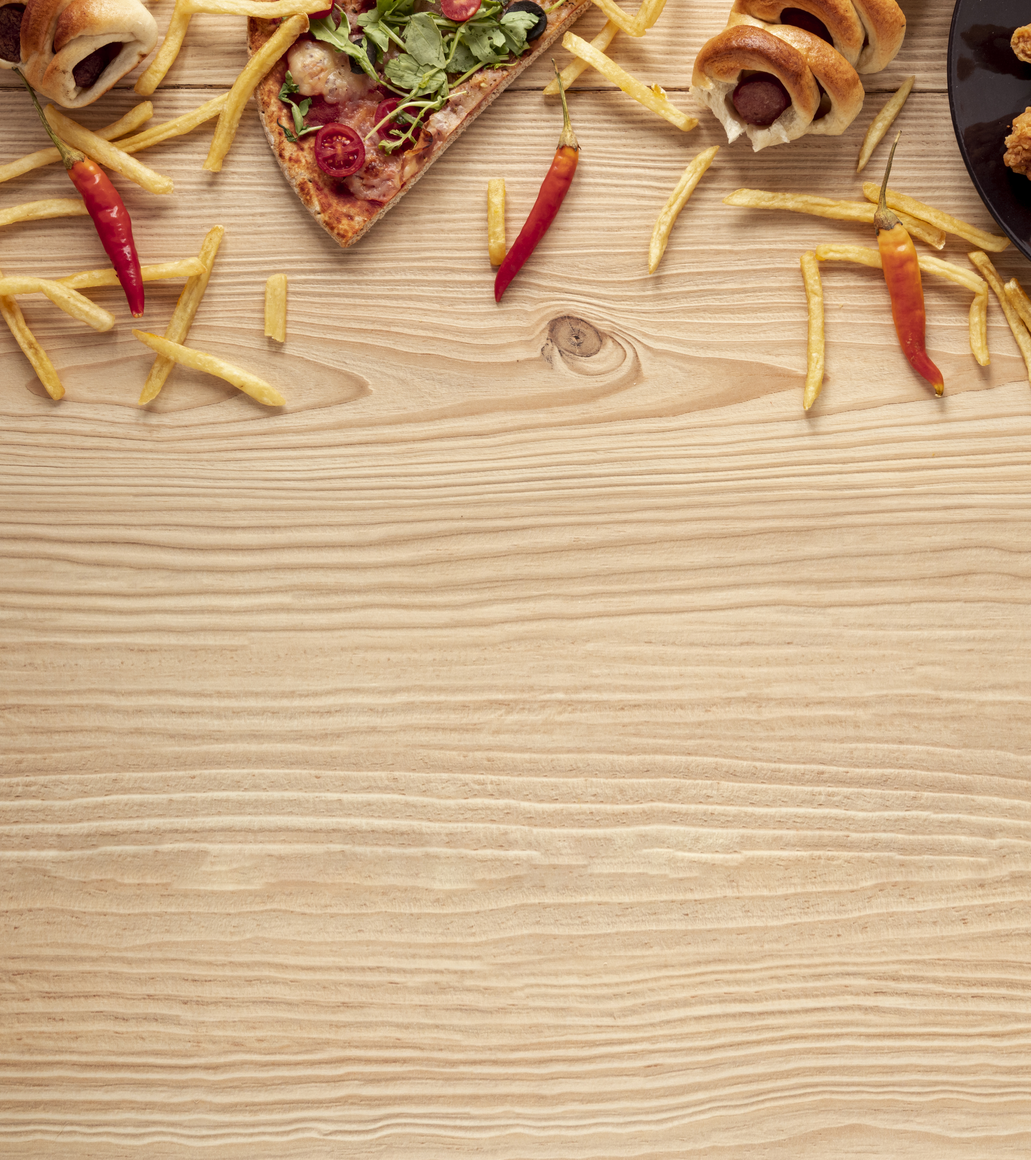
On Campus Food Ordering System
Group 2
Vyshampa Maringanti
Pratigya Shakya Pradhan
Shelly Choudhary

Slide 2
Table of contents
Objectives
Product backlogs
Class Diagram
Screenshots
Retrospective
Future Enhancements

Slide 3



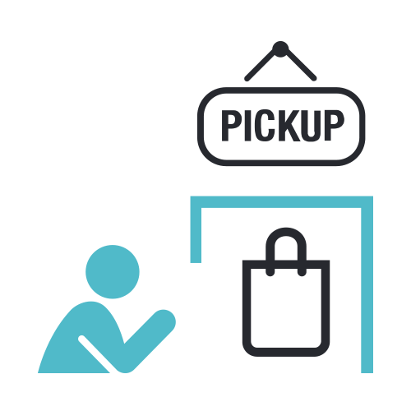
OBJECTIVE
1. Choose Cafe
2. Order Food
3. Pick Up Food
The user can select the food item from the menu and place the order from the particular cafe
The user can pick up the order from the café after his order is ready
The user can choose the café from which he wants to order food from in the website

Slide 4
Product Backlog for sprint 3
ID | User Stories
6 | As a user, select one of the café options to view menu
15 | As an employee, add/view item
9 | As a user modify order by removing item or adding new item.
10 | As a user, make the payment and get confirmation.
13 | As an admin add employee ti the system
19 | As an employee view order
22 | As a user write feedback

Slide 5
Sprint 3 Product backlog
ID | User Stories
23 | As an admin, view feedbacks of all the cafe
24 | As an employee, view feedbacks of the designated café.

Slide 6
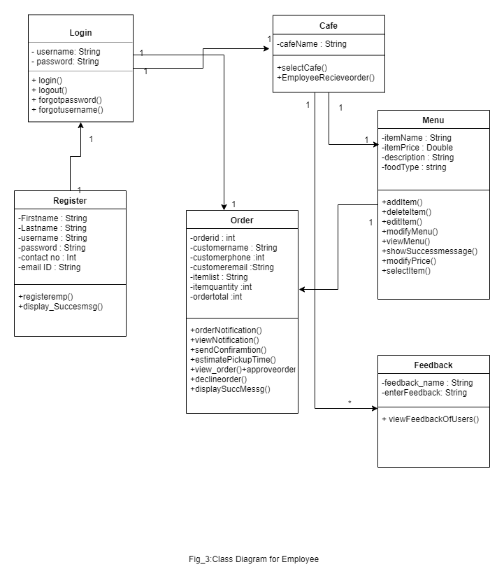
Class Diagram For Employee

Slide 7
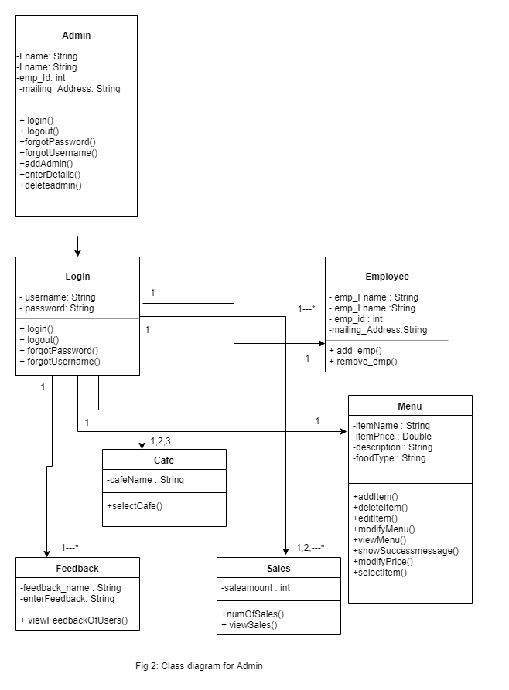
Class Diagram For ADMIN

Slide 8
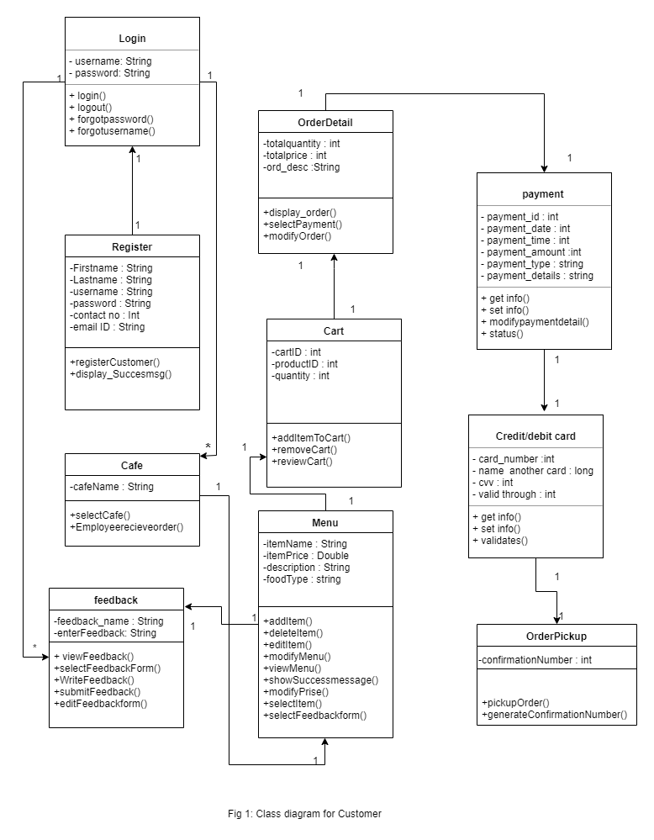
Class Diagram For Customer

Slide 9
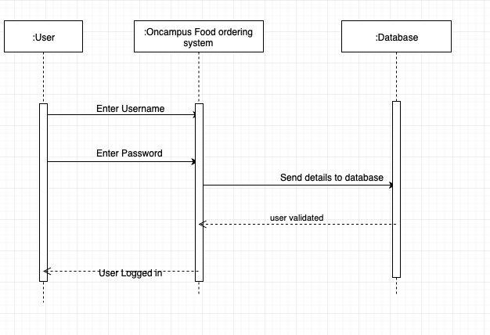
Sequence Diagram for login

Slide 10
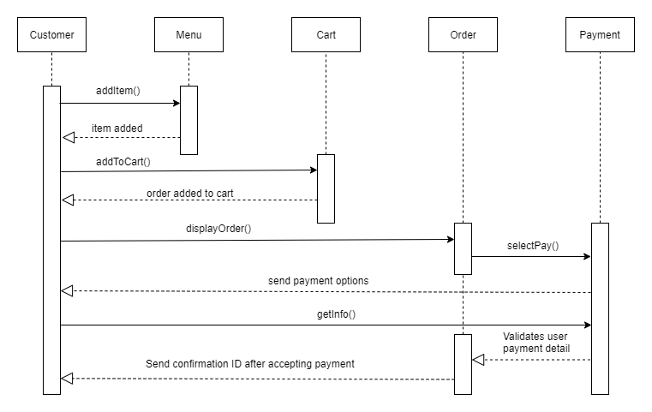
Sequence Diagram for Customer

Slide 11
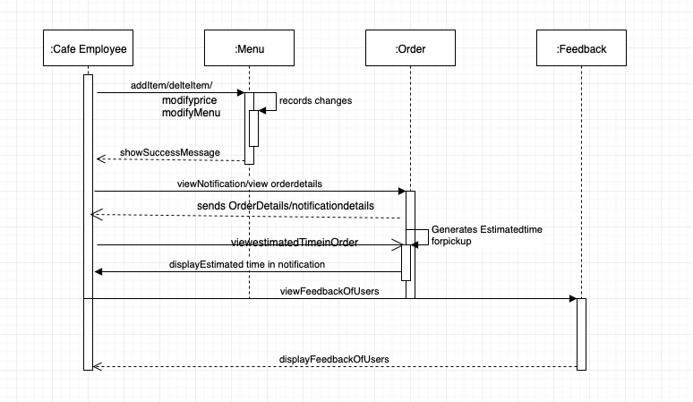
Sequence Diagram for Employee

Slide 12
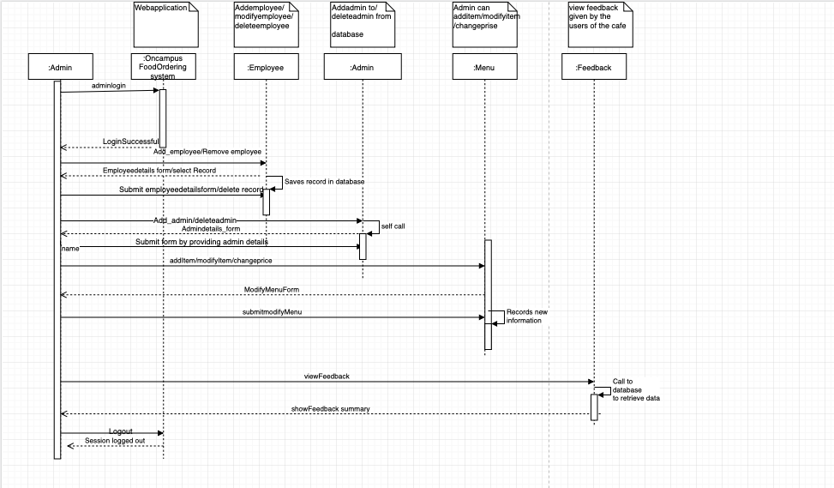
Sequence Diagram for Admin

Slide 13
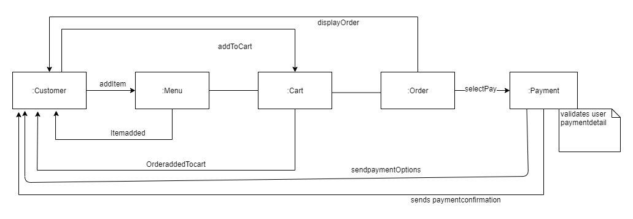
Communication Diagram for Customer

Slide 14
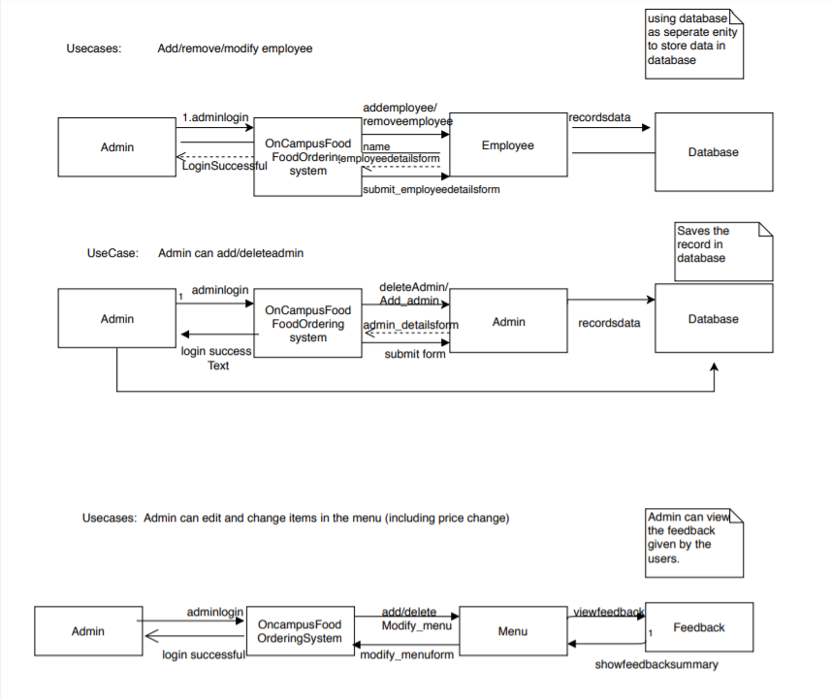
Communication Diagram for Admin

Slide 15
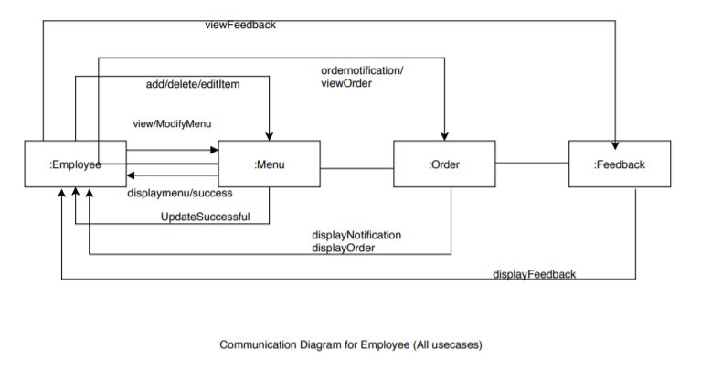
Communication Diagram for Employee

Slide 16
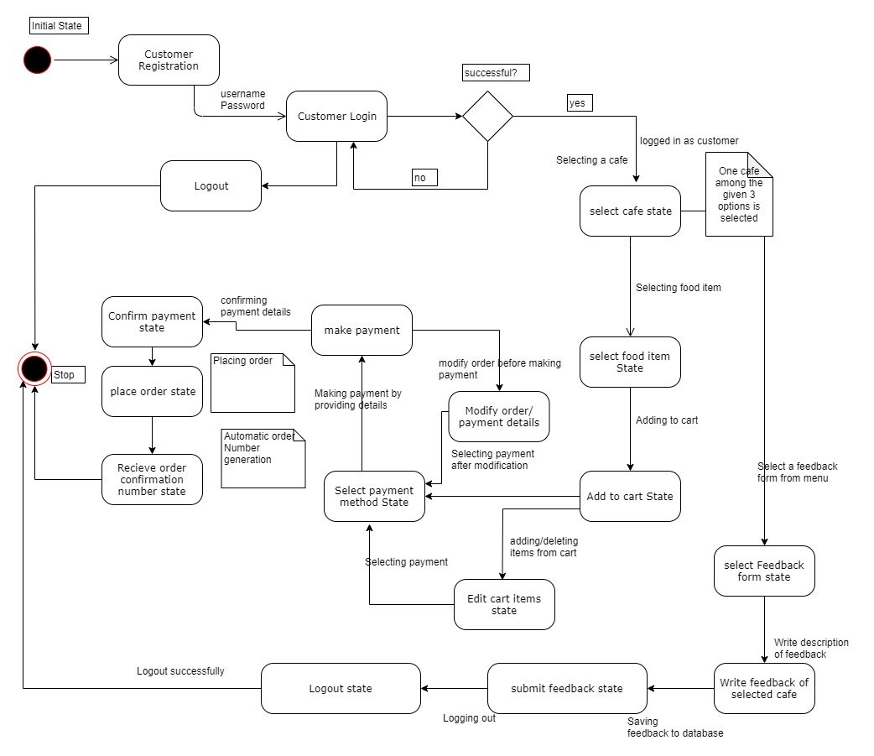
State Diagram for Customer

Slide 17
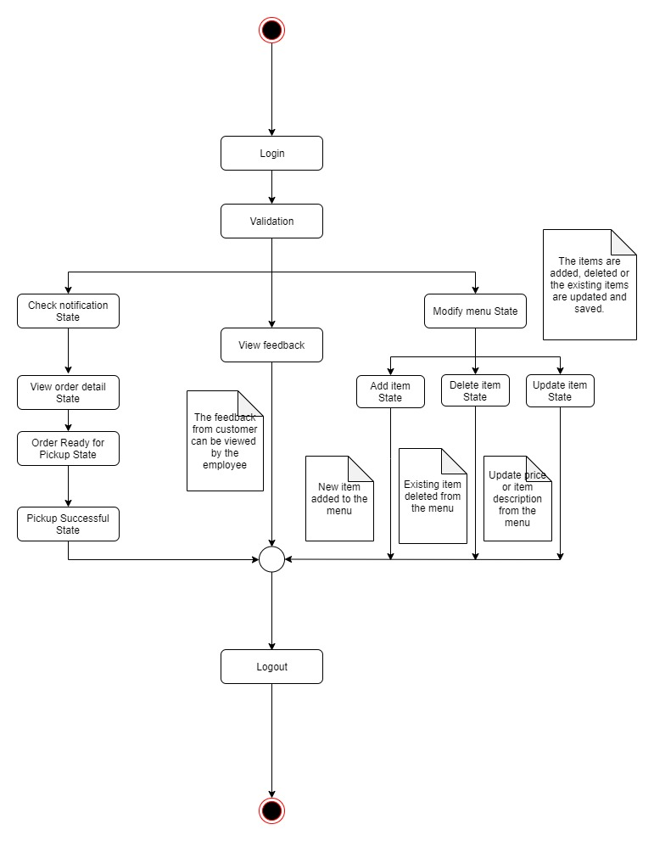
State Diagram for employee

Slide 18
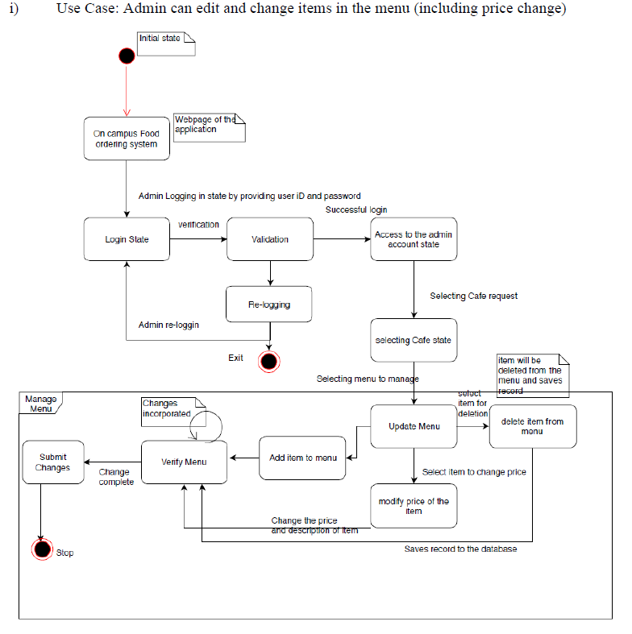
State Diagram for admin

Slide 19
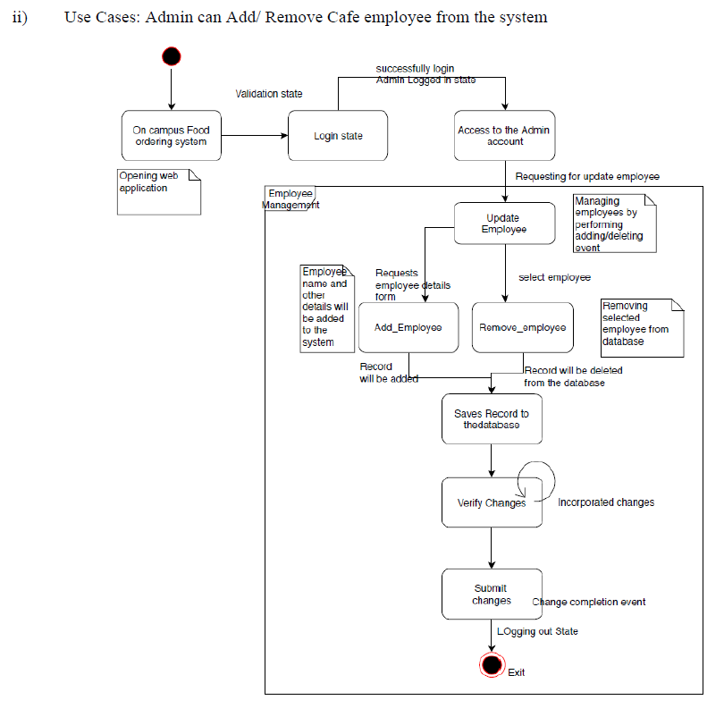
State Diagram for admin

Slide 20
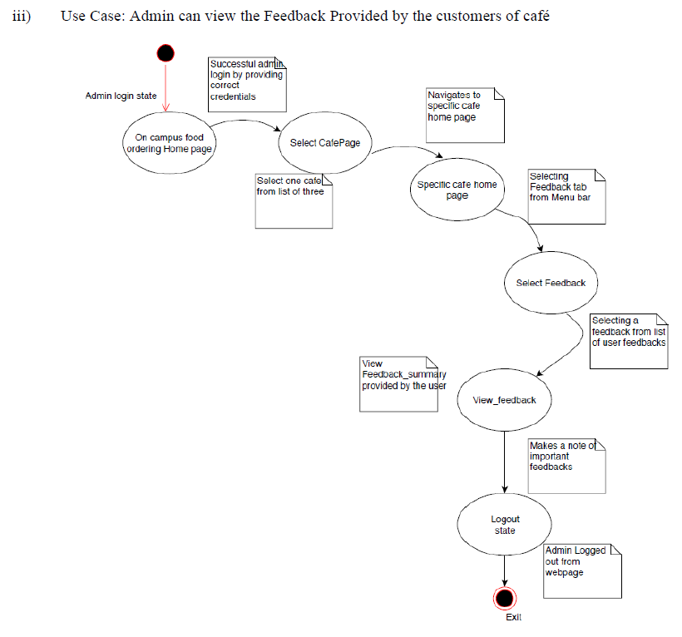
State Diagram for admin

Slide 21
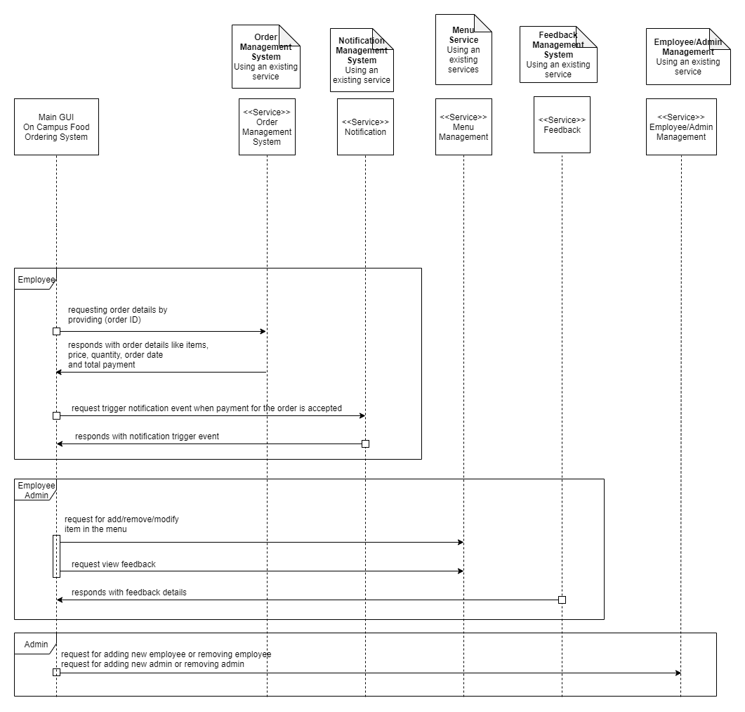
Soa for admin and employee

Slide 22
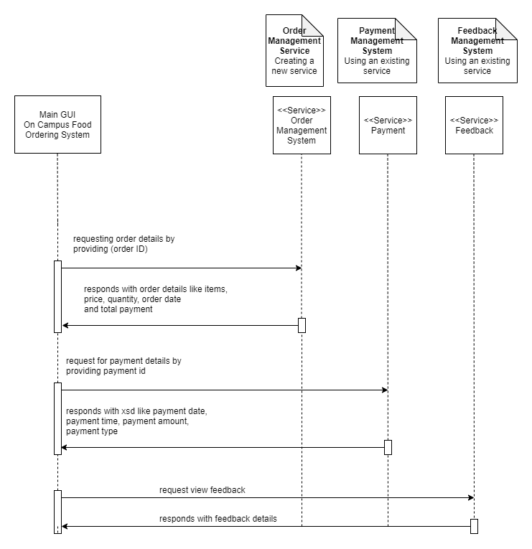
Soa for customer

Slide 23
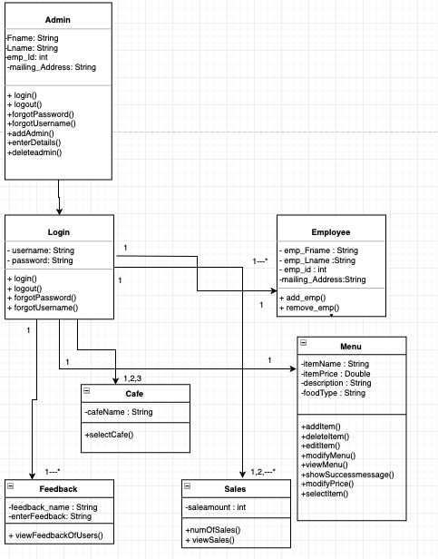
GRASP PATTERN

Slide 24
Test Case 1
Admin can add item to the menu.
Negative Test Case:
If admin leaves without entering data it throws an error message.
Positive Test Case:
Food Item is successfully added to the Menu.

Slide 25
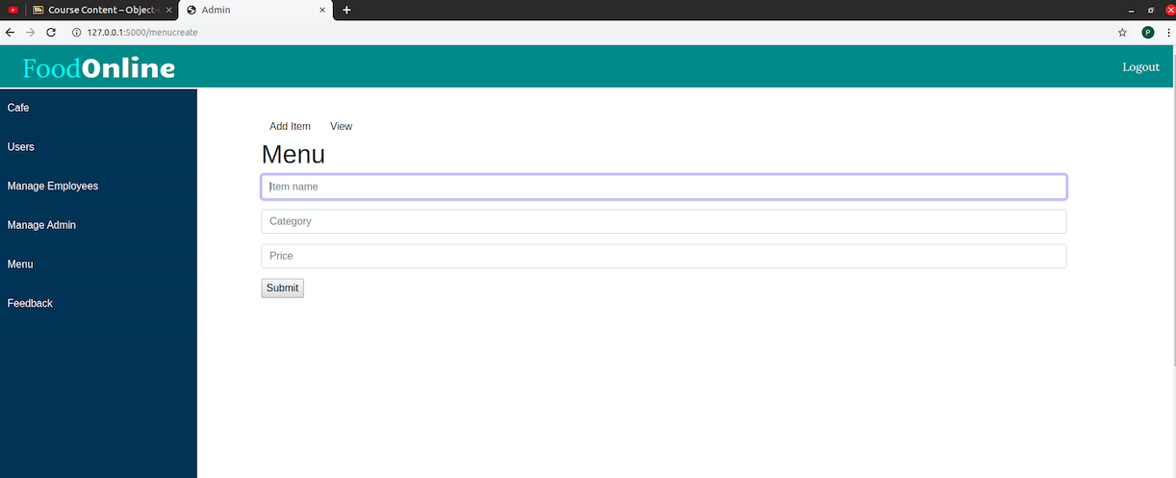
Admin Adding new category food item to the menu

Slide 26
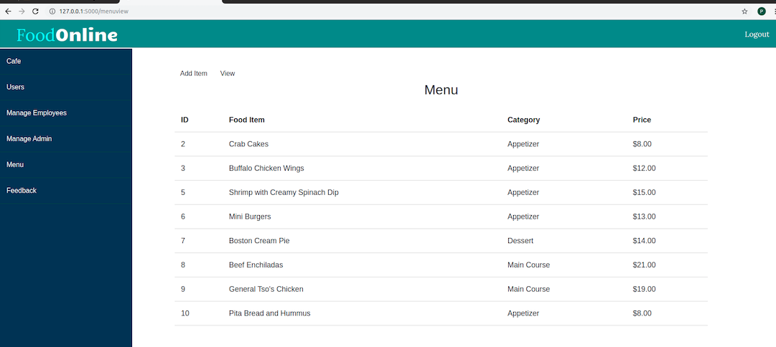
Food ITEM SUCCESSFULLY ADDED

Slide 27
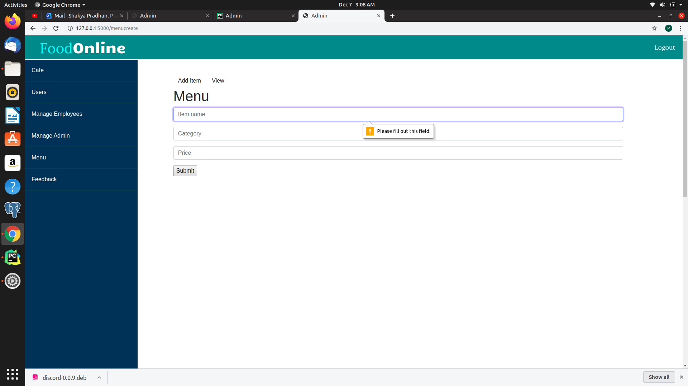
Negative test case for admin

Slide 28
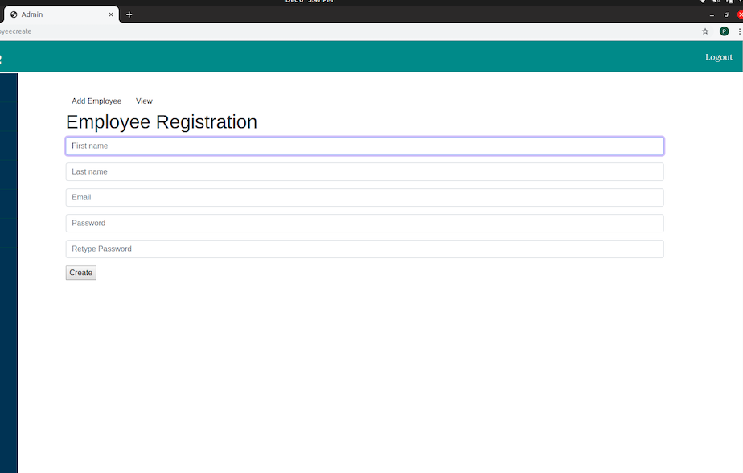
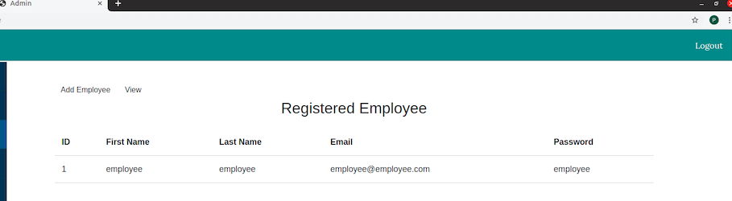
Admin REGISTERING EMPLOYEE

Slide 29
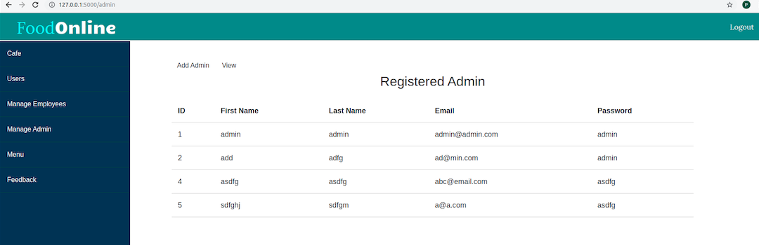
Admin Registering New ADMIN

Slide 30
Test Case 2
Admin tries to add the same food item twice, system should not allow to do so.
Negative Test Case:
Application throws an error message ”Duplicate data”

Slide 31
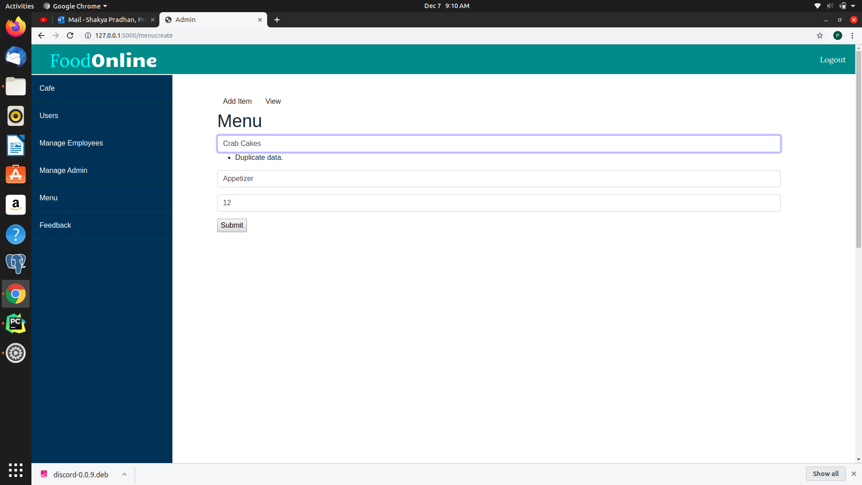
Application throws an error message for duplicate data

Slide 32
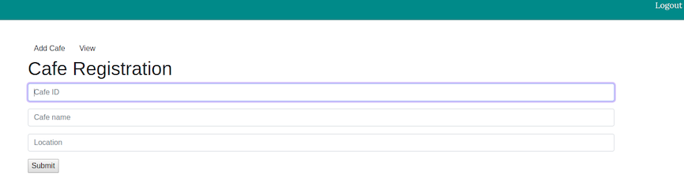
ADMIN registering NEW CAFÉ TO THE SYSTEM

Slide 33
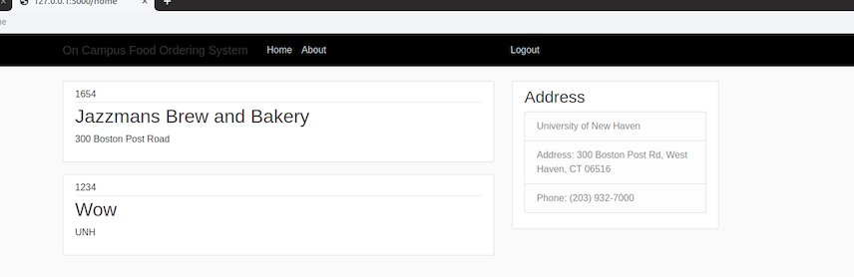
HOME PAGE OF cafe

Slide 34
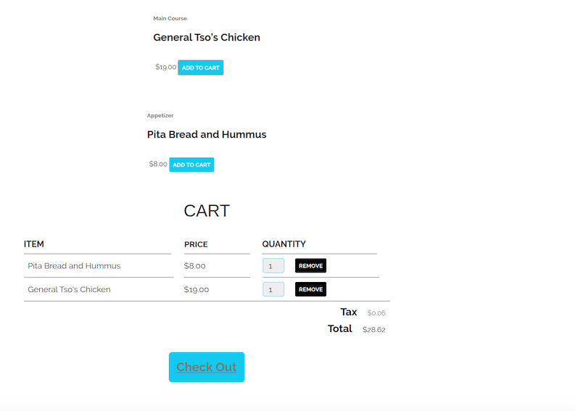
ADD to CART

Slide 35
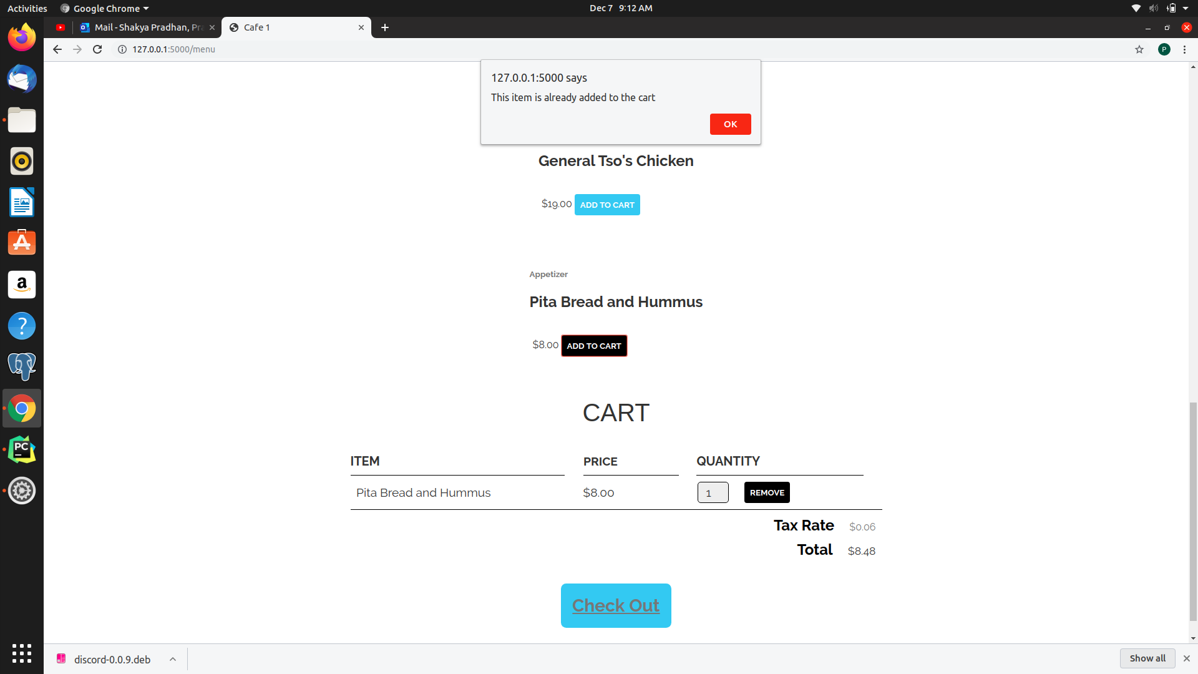
check out

Slide 36
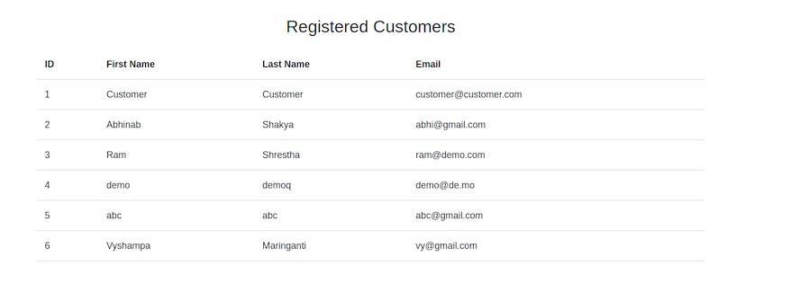
Admin Tracking number of customers

Slide 37
Retrospective : Sprint III
What worked well
No issues with the group members.
What didn’t work well
Time crunch due to which certain parts of the project were overlooked.
Lessons learned
Working as a group requires patience and understanding.
Impact on project
Could have worked on more features but couldn’t due to time crunch.
Restarting and completing the entire project with OO language after second sprint was difficult.
Debugging and error correction is painful and time-consuming task.
Difference in the vision for the project led us to splitting group in two.
Due to this we faced time crunch and lot of stress in completing the project
We learned a new framework within the given time frame and tried our best to implement all the features.
Since none of group members had previous experience on working on a real time project, at times the understanding concepts of linking different aspects of the application was difficult.
It gave us an opportunity to learn new framework and database.
It is important to have similar vision between the group members.

Slide 38
Technology and Tools Used
Web Development
HTML
CSS
JAVA SCRIPT
Database
POSTGRES
SQLALCHEMY
Framework
PYTHON FLASK

Slide 39
FUTURE ENHANCEMENTS
Update Design and Add payment module
Edit and delete privileges to admin and employee
Notify customer and employee when the order is placed
Make this application available for iOS and Android
Monitoring sales and generating reports

Slide 40

Let’s get into the Demo

Slide 41
THANK YOU

